Slide 1
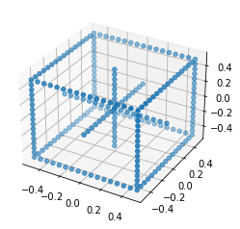
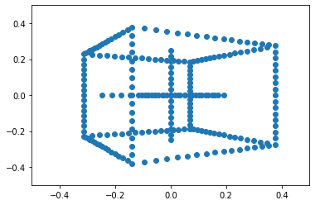
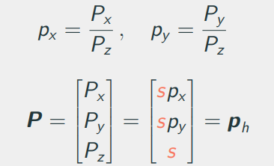
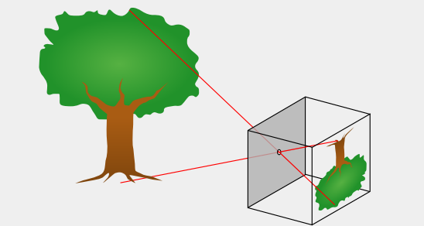
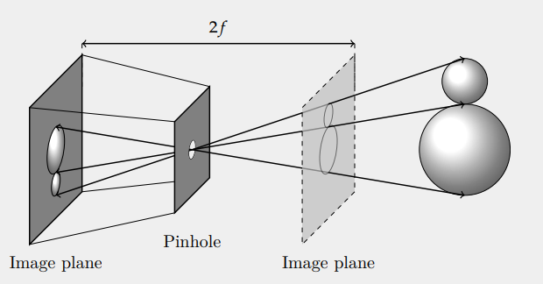
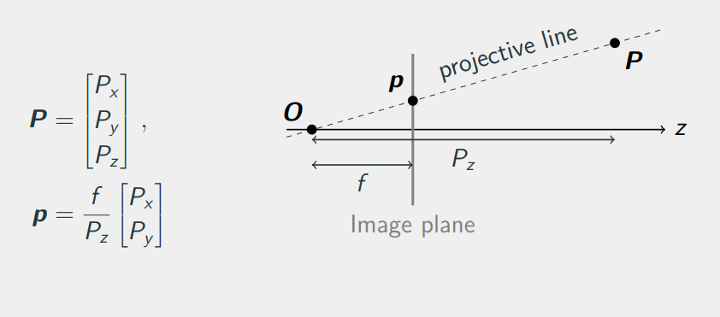
Pinhole camera model & Homogeneous coordinates q = K[R|t]Q = PQ

Slide 2
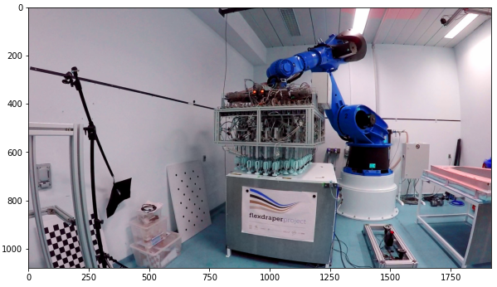
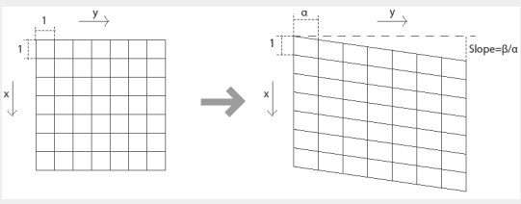
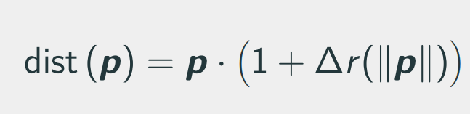
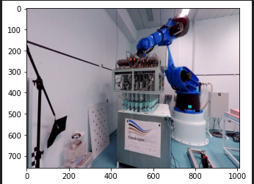
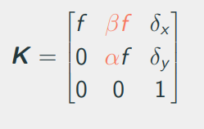
Camera model & homographies
Camera model parameters, non-square/rectangular pixels
Origin of distortion and treatment
Homography derivation, use & interpretation
Linear algorithm for estimating H

Slide 3
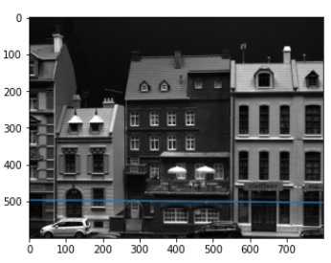
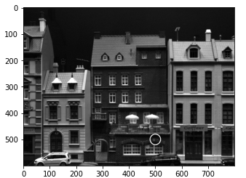
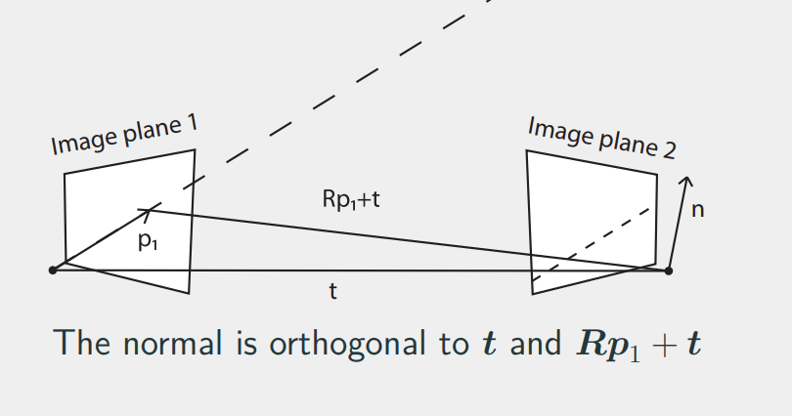
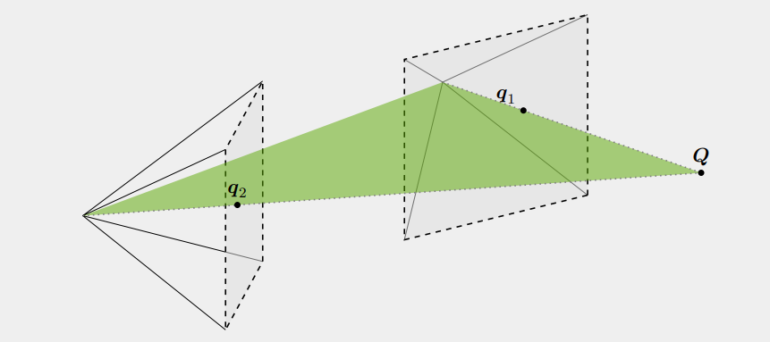
Stereo vision & triangulation. Multiview geometry. Essential & Fundamental matrices. 0 = p’Ep; 0 = q’Fq; p - 3D; q – 2D projection.
Derive and apply Fundamental & Essential matrices
The derivation of Essential uses the normal of epipolar plane interpretation, but could also be an epipolar line
Linear algorithm for triangulation
Pros & cons of linear algorithm

Slide 4
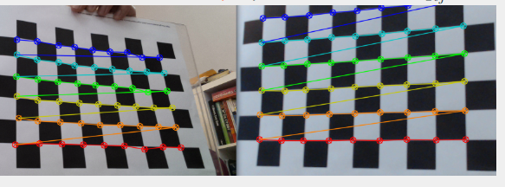
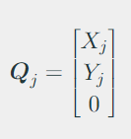
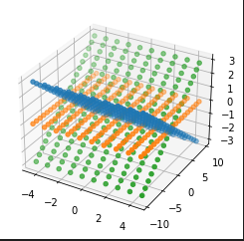
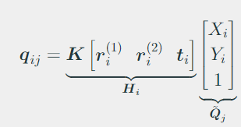
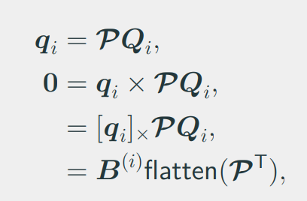
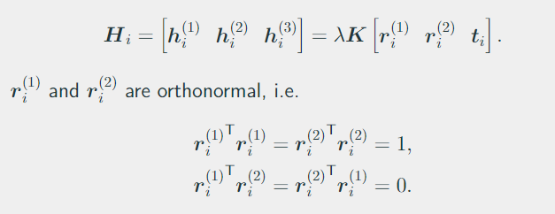
Camera calibration & DLT

Slide 5
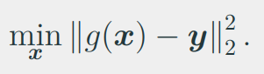
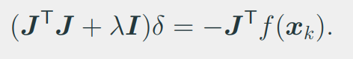
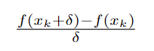
Non-linear triangulation & calibration
Optimization. Levenberg-Marquardt. Could be used for many of the problems we encounter: homography est, camera calibration, triangulation…
Jacobians: analytical, autodiff (ex. pytorch) or simply finite difference approximation (Taylor series, forward, backward, central 2nd order)
Rotation representations. Euler – minimal, suffers from gimbal lock. Axis angle – theta around axis. Quaternions – gold standard.
Bundle adjustment – after having the parameters optimize over all points including 3D positions of corners.

Slide 6
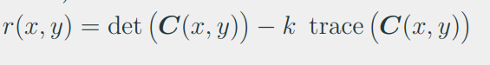
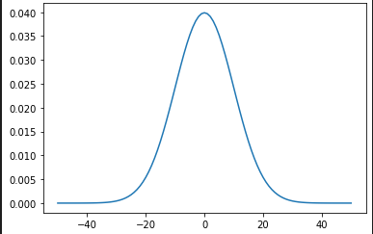
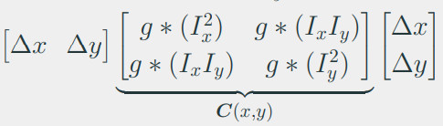
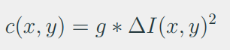
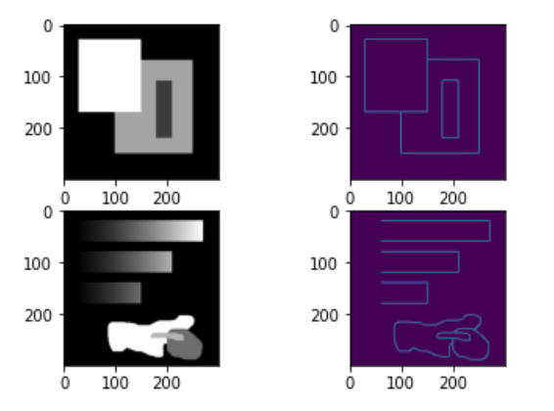
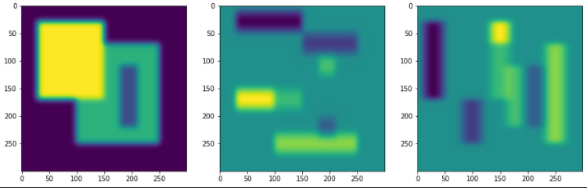
Simple features. Canny. Harris
Image correspondence (problems: scale, rotation, translation, lighting)
Image features (key points, focus on the area around pixel, describe)
Explain image filtering (gaussian kernel). We know analytical derivative of gaussian filter.
Harris corner is defined as having large gradient in all directions. We can get this metric from the averaged Hessian matrix.

Slide 7
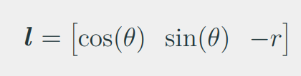
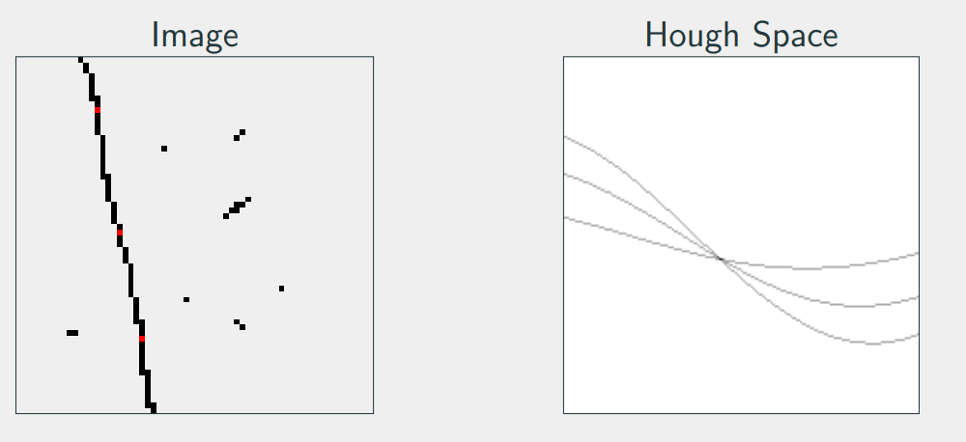
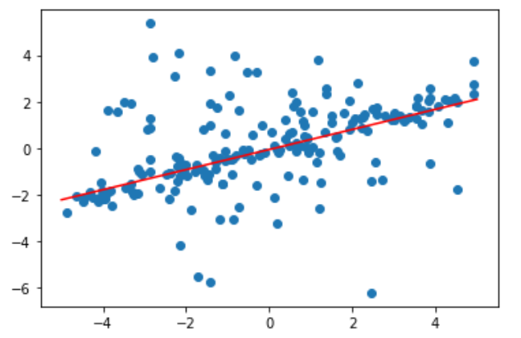
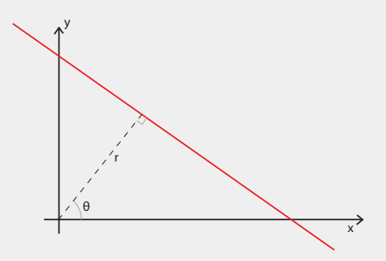
Robust model fitting. RANSAC. Hough transform.
Hough transform – r,theta representation. Idea: we can sample our original image and draw all possible lines going through that point in Hough Space. Do that for all points, the maximum intensity will represent line in original image.
We can generalize to more complex models, but it becomes impractical for more than three degrees.

Slide 8
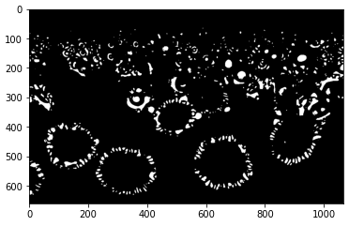
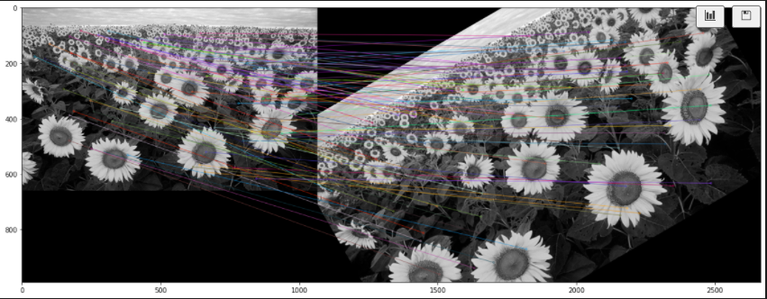
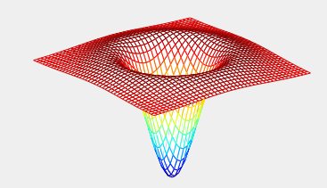
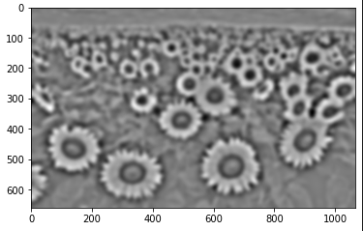
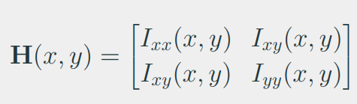
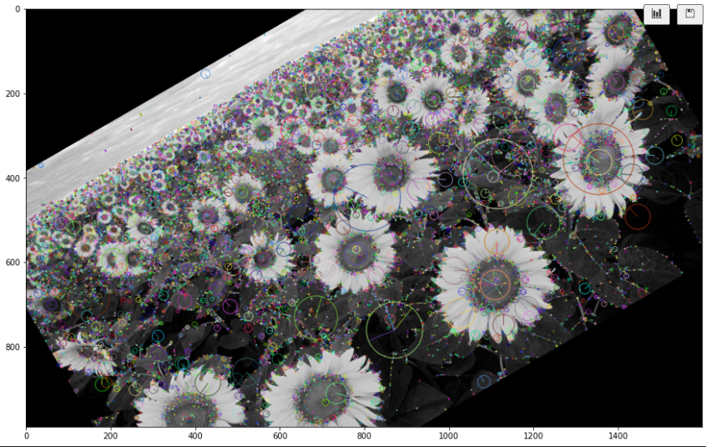
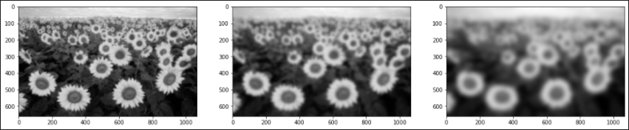
Blobs & SIFT
H measures curvature at a pixel. Trace of H is what we use for blob detection (essentially intensity of curvature, point of interest bc of this property). DoG gives an approximation of trace(H).

Slide 9
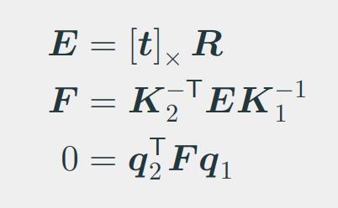
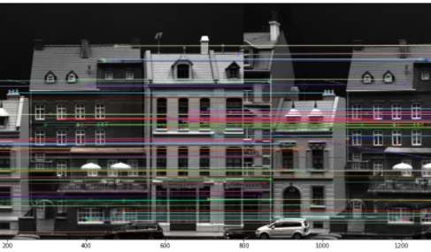
Constrained geometry feature matching
Eight-point algorithm (Fundamental matrix, expressing corresponding point lie on their epipolar lines). Degrees of freedom, one pair fixing single.
RANSAC for improving the estimate. Sampson’s Distance.
Choosing threshold for RANSAC. Chi-square Distribution Table. m is taken from error dimensions; ex. Euclidean distance is two numbers.

Slide 10
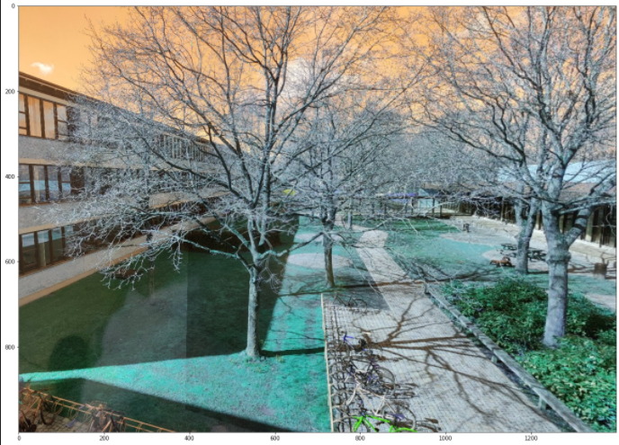
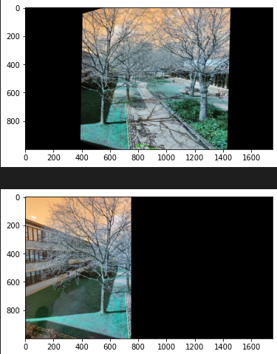
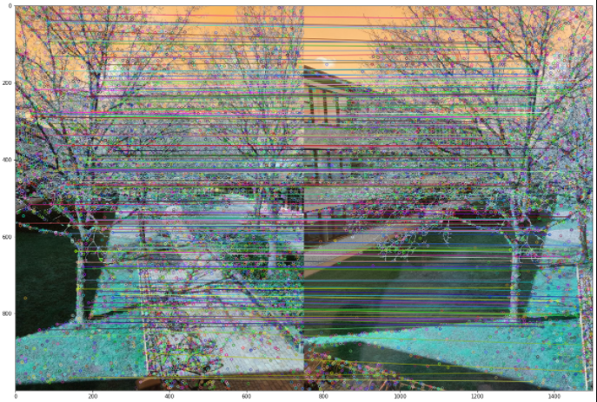
Image stitching
RANSAC for fitting Homographies. Error measure? – map both pair point back and forth and take squared difference between pair in the sample.
Warping using Homography
Stitching:
Generate all pixel coordinates in the reference image
Map these to the other image using Homography
Interpolate pixels at the transformed locations
Finally stich the images. Overlapping points can be average out, for instance.

Slide 11
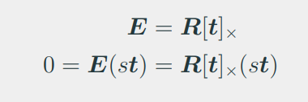
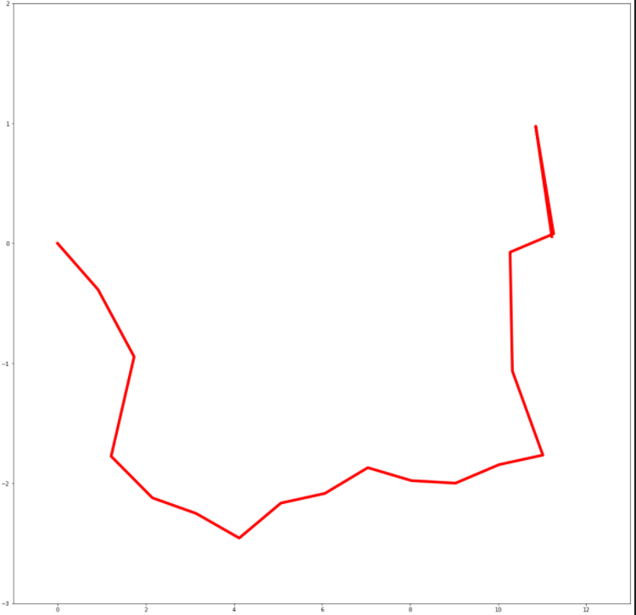
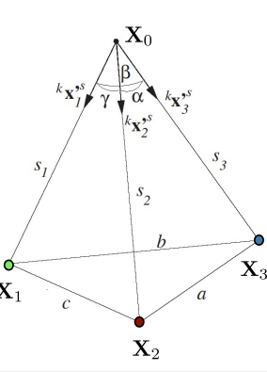
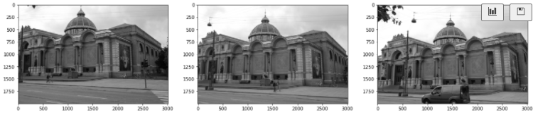
Visual odometry
SIFT (or any other), matching
Essential matrix, decomposition (R,t)
Scale of t is unknown, we can fix it from the first two frames
Triangulation from first pair
PnP to estimate pose of camera in third

Slide 12





Structured light
Rectification
Unwrapping, pattern
Matching pixels
Disparity map
Triangulate matches

